Slide 1
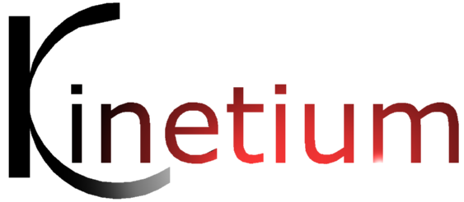
Effective Business Architecture using MAp
This is a short overview of MAp. MAp describes systems in terms of interacting objects at multiple levels of abstraction, spanning business domains, business strategy and goals through application, technical, and deployment architecture.
It covers:
What does MAP set out to deliver?
The Formal Architectural Framework underlying MAp
Realistic Pragmatics for using MAp
Retrospective – MAp in a Broader Context

Slide 2
Outline from John
Walkthrough an example – top down, all views, integration
Enable sponsors, sr. managers etc. to understand roles, responsibilities, and hand-offs in PRODUCING the BPM
Enable them to understand the roles etc. IN THE BPM
Enough detail to Execute (manual or otherwise)
Useful input for downstream work
Show cube framework
Explain applies at all levels (through black box, white box…)
Relation to business, architecture, and implementation teams
Extracting max value
Goals: Blind Spots, Metrics, monitoring, org design, controls, arch reviews (conformance? styles?), UI design and workflow generation (needs more detailed action spec, snapshot → UI → scenario → walkthrough), vendor selection
Process: execute (add resources, …?), simulate,
Presentation – literate style + flexible form
BPMN specifics
High level views – Conversation? Choreography? Joint actions?
Outside BPMN – interface view, resource view
Refine ≠ Top-Down
Bottom-up, logical proof or establish by experiment | trust | authority, ask Why / What else / …
See Property-Part diagrams ; goals++ provides same impact / exposure / trusted base / ...
Related experience in other companies
Include project & stakeholder profiles

Slide 3
Outline
What is MAp?
Formal Architecture Framework
Goal Modeling
Viewpoints and Concerns – Black Box, White Box, Technical
Architecture Style
Process Pragmatics
Iterative and Incremental
Multiple Project "Routes" through MAp
Flexible Models and Domains
Effective BPMN in Business Architecture

Slide 4
Effective Business Architecture in MAP
Wanted: an architecture that clearly aligns from business need to technology solution
MAp – one systematic approach to doing this
Clearly separated viewpoints and models to design or analyze at multiple levels
1. Business Driven
business goals, terminology first
business process to meet goals
relate multiple roles, systems, views
2. Traceability
bridge Business and IT
precise shared vocabulary
critical business questions early
5. Reuse Process
reuse business models
… and architectures
… and implementations
develop for reuse
develop with reuse
4. Consistent Architecture
blueprint for consistency
principles, patterns, styles
both business and technical
standards for interoperability
3. Design and Assemble Pluggable Service Components
federated components, services; not monolithic systems
clear interfaces and responsibilities
reusable and maintainable building blocks
Builds upon best practice and industry standards for architecture: UML, BPMN, EDOC, RM-ODP, Catalysis, Simple Components, RUP, Problem Frames, Goal Modeling

Slide 5
Two Separate Aspects to Approach
Formal Framework
Goals
Viewpoints
Concerns
Models
Refinement
Architecture Styles
Process Pragmatics
Routes: Roadmap, Construction, …
Different Entry Points
Iterative and Incremental
List, Draft, or Dressed Templates
Guidelines
Checklists
A clear and uncompromising reference
Architecture always ties back to goals.
Different presentation suitable to audience
Clear and unambiguous architecture
Consistency rules across descriptions
Full of pragmatic compromise
How to prioritize and focus work?
How much detail is appropriate and when?
How to show early value and reduce risk?
How to customize to project needs?

Slide 6
Outline
What is MAp?
Formal Architecture Framework
Goal Modeling
Viewpoints and Concerns – Black Box, White Box, Technical
Architecture Style
Process Pragmatics
Iterative and Incremental
Multiple Project "Routes" through MAp
Flexible Models and Domains
Effective BPMN in Business Architecture

Slide 7
Goal is not the same as System Specification
Goal:
Laptop info → audience minds
Projector
Specification:
signal → light
Goals are typically 1 or more levels “removed” from the target software system
Goal to observe some things in the “problem domain” to control other things
Target system + other elements + domain properties needed to meet the goal
Target system = projector
Other elements = screen, cables, laptop, speaker, audience, room
Domain properties = audience location, room brightness, …

Slide 8
The MAP questions
1. Why? What is the goal being achieved outside? What does it control and observe?
Goal
4. What is the boundary of our “box”?
2. What are relevant domain properties? How is our box combined with other parts to solve it? Are there better approaches?
3. What are the properties of all domain elements, other solution components & connectors relevant to meeting the goal?
5. What properties of the box visible at boundary?
functionality: services offered and required, events handled, information handled
others: volumes, performance, location, security, tech platform
Projector
Specification
6. What internal “boxes” can be combined to do the job?
Existing? New?
How to partition behavior and information responsibility to meet end-to-end needs?
7. What consistent principles, patterns, or styles guide our design and are shared across components?
8. What are properties of each internal box?
functionality: services offered and required, events handled, info handled
others: volumes, performance, location, security, tech platform

Slide 9
Outline
What is MAp?
Formal Architecture Framework
Goal Modeling
Viewpoints and Concerns – Black Box, White Box, Technical
Architecture Style
Process Pragmatics
Iterative and Incremental
Multiple Project "Routes" through MAp
Flexible Models and Domains
Effective BPMN in Business Architecture

Slide 10
Goals on the Problem Domain
7: Multiple concerns: functionality, security, performance, technology…
2a: Goal - Factories supplied just in time from supplier warehouses
Functionality
Security
Performance
Technology
…
3: Refinement to sub-goals + domain properties on sub-domains
1: Problem Domain – factories, supplies, warehouses, partners, existing systems
3c: delivery: facts about a sub-domain
3b: predict production load, optimize supply schedule
3a: track inventories
4a: Model of solution and problem components grow together
4b: Scope of sub-goals get narrower.
Some assigned to components.
Factory Supply Optimizer
production load predictions
supply scheduling
supplier
inventory
deliveries
scheduling
predictions
2b: Model of problem domain starts here
5: Applications, Components, Connectors
– required or given properties for each
– end-to-end satisfaction of goals
6: Goals and Domain Model are refined in parallel, to granular goals and components

Slide 11
Relating to The Cube
Highlight – goals & domain properties : across structure, behavior, information, & granularity
Functionality
Factory Supply Optimizer
production load predictions
supply scheduling
supplier
inventory
deliveries

Slide 12
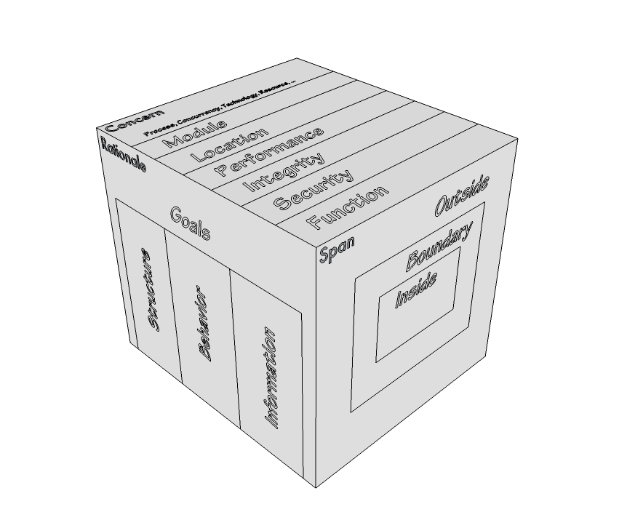
Goals “frame” An Architecture
Concerns can be about function, security, transactions, performance, etc.
Goals are desired properties of things in the problem or business domain
Why are they doing it?
Who is doing stuff?
What are they doing, and with whom?
What are they doing it to?
Goals (desired properties) Facts or Assumptions (given properties) can be about structure, behavior, information
Span or Granularity of interest: boundary of a box, or its outsides, or its insides

Slide 13
MAp Viewpoints (for S)
Process supports goals
Information supports goals, process
Domain / Biz
Architecture
1
Outside
Domain: Information, events
Goals
Process
Goals – success criteria
Black box assembly includes S,
Supports business model
Traceability
Mapped Black box Assembly (including S)
S
1
S
Component Architecture
Black box Spec (of S)
S
E
D
S
1
2
S: Information
Boundary
Architecture Styles: Principles, Patterns, Guidelines, Rules
Black-box Specification (of S)
4
S: Behavior
3
Black box view of S
Architecture styles, patterns: across viewpoints, projects
White box view of S
sub-component s1…s3
Partitions behavior & information
1
2
S
S
Component Architecture
White box design (of S)
s2
Inside
s2
s1
3b
s1
s3
3a
s3
4
Information
Behavior
Each sub-component could be drilled-down if needed

Slide 14
Loans Example – Goals, Information, Process Model
Goals clearly defined in domain terms.
Goals refined into adequate sub-goals
Choice of subgoals: necessary? sufficient?
Minimize Credit Exposure Risk
Maximize Return
Predict Risk
….
Adjust Risk Exposure Factors
…..
Unambiguous definition of domain terms
Object types, attributes, events
Terms defined in “drill-down” as needed
Track Risk Prediction History
Improve Predictive Model Over Time
Process activities clearly defined in domain terms
Business process demonstrably supports goals

Slide 15
Loans Example – Black-box partition & mapping of Domain Model
Clear authoritative ownership of information by top-level components
Top level “black-box” components
Loans Management
Reference Data System
Collateral Management
Explicit dependencies between information across components.

Slide 16
Loans Example – Black Box Assembly
Ports  define connection points on components
Services provided and required explicit
Logical connections between components clear
Clear underlying information ownership
Loans System
Reference Data System
Collateral Management
System
Interfaces specified explicitly

Slide 17
Outline
What is MAp?
Formal Architecture Framework
Goal Modeling
Viewpoints and Concerns – Black Box, White Box, Technical
Architecture Style
Process Pragmatics
Iterative and Incremental
Multiple Project "Routes" through MAp
Flexible Models and Domains
Effective BPMN in Business Architecture

Slide 18
Roadmap Route
Initial issues, objectives, stakeholders, etc.
buried business knowledge
problems and opportunities
refine goals and obstacles
for target state work
Frame the Problem: formalize problem, syndicate with stakeholders
Goals model Key domain terms
known reference architectures,
best practices, etc.
top-level problem definition,
domain terms to map,
priorities, focus areas
Analyze The Current State
Define The Target State
Business architecture
scenarios and process sketches
key information terms
problems and opportunities
Business architecture
principles and styles
processes, roles, activities
validation vs. goals and obstacles
problems and opportunities
Component architecture:
principles and styles
[black-box] top-level assembly
[black-box] context: ports, use cases
[white-box] sub-component assembly
[white-box] end-to-end collaborations
technical properties, mapping styles
validation vs. goals and obstacles
target reference architecture
e.g. components, functions,
information … for inventory
Component architecture
application inventory and map (against domain, target reference)
non-functional and technical props
problems and opportunities
Plan The Migration
relationship to other roadmaps and projects
goals, constraints, architectural sequencing dependencies
migration principles, stages: evolving architecture snapshot with gaps, cost
cross-project
“program” conformance
project funding
project requirements
project funding
project requirements
project funding
project requirements

Slide 19
Emphasis Changes Across Projects
Project | Goals | Structure | Behavior | Information
Perfect Pipelines | High CXO & senior management | High Organization, Roles, Business Capabilities | Low Business Capabilities | Medium Business Capabilities
Factory Automation | Medium | High Components (COTS + built) | High Business process, component interactions | High
Information Security | High | Medium | Low | Medium
Agency Management | Medium | Medium | High | High

Slide 20
So MAp is …
Model-driven approach to domain and business-aligned architecture
Address both business and technical concerns through models
Model of goals and the problem domain those goals are concerned with
Model of structure of business (roles, organization) or technology (components) with ownership, responsibilities, and interactions
Clear separation of viewpoints for simpler architectural descriptions
Different entry points and routes applicable to different projects
Can be used to differing degrees of completeness and rigor as needed

Slide 21
Outline
What is MAp?
Formal Architecture Framework
Goal Modeling
Viewpoints and Concerns – Black Box, White Box, Technical
Architecture Style
Process Pragmatics
Iterative and Incremental
Multiple Project "Routes" through MAp
Flexible Models and Domains
Effective BPMN in Business Architecture

Slide 22
Using MAp … Where This Overview Fits In
MAP can be applied as rigorously or lightly as appropriate
Philosophy of clear content with flexible form
The underlying concepts of MAP are few and simple
Simple ≠ Easy
Applying it effectively takes a focused and disciplined mindset
Recommended path to applying MAp includes
Incorporating into existing SDLC, roles, templates etc.
Project planning and definition including MAp tailoring
MAP overviews (2 hour – 1 day)
MAP in-depth training course, different for different audiences (4-5 days)
Project focused workshop (1-2 days)
MAP mentor working with team on their first project
Other resources related to MAp include
Method Overview
Method activities and steps guide
Concept Maps
Deliverable checklists
Deliverable templates
Summary reference sheets
Detailed documentation
Tool customizations

Slide 23
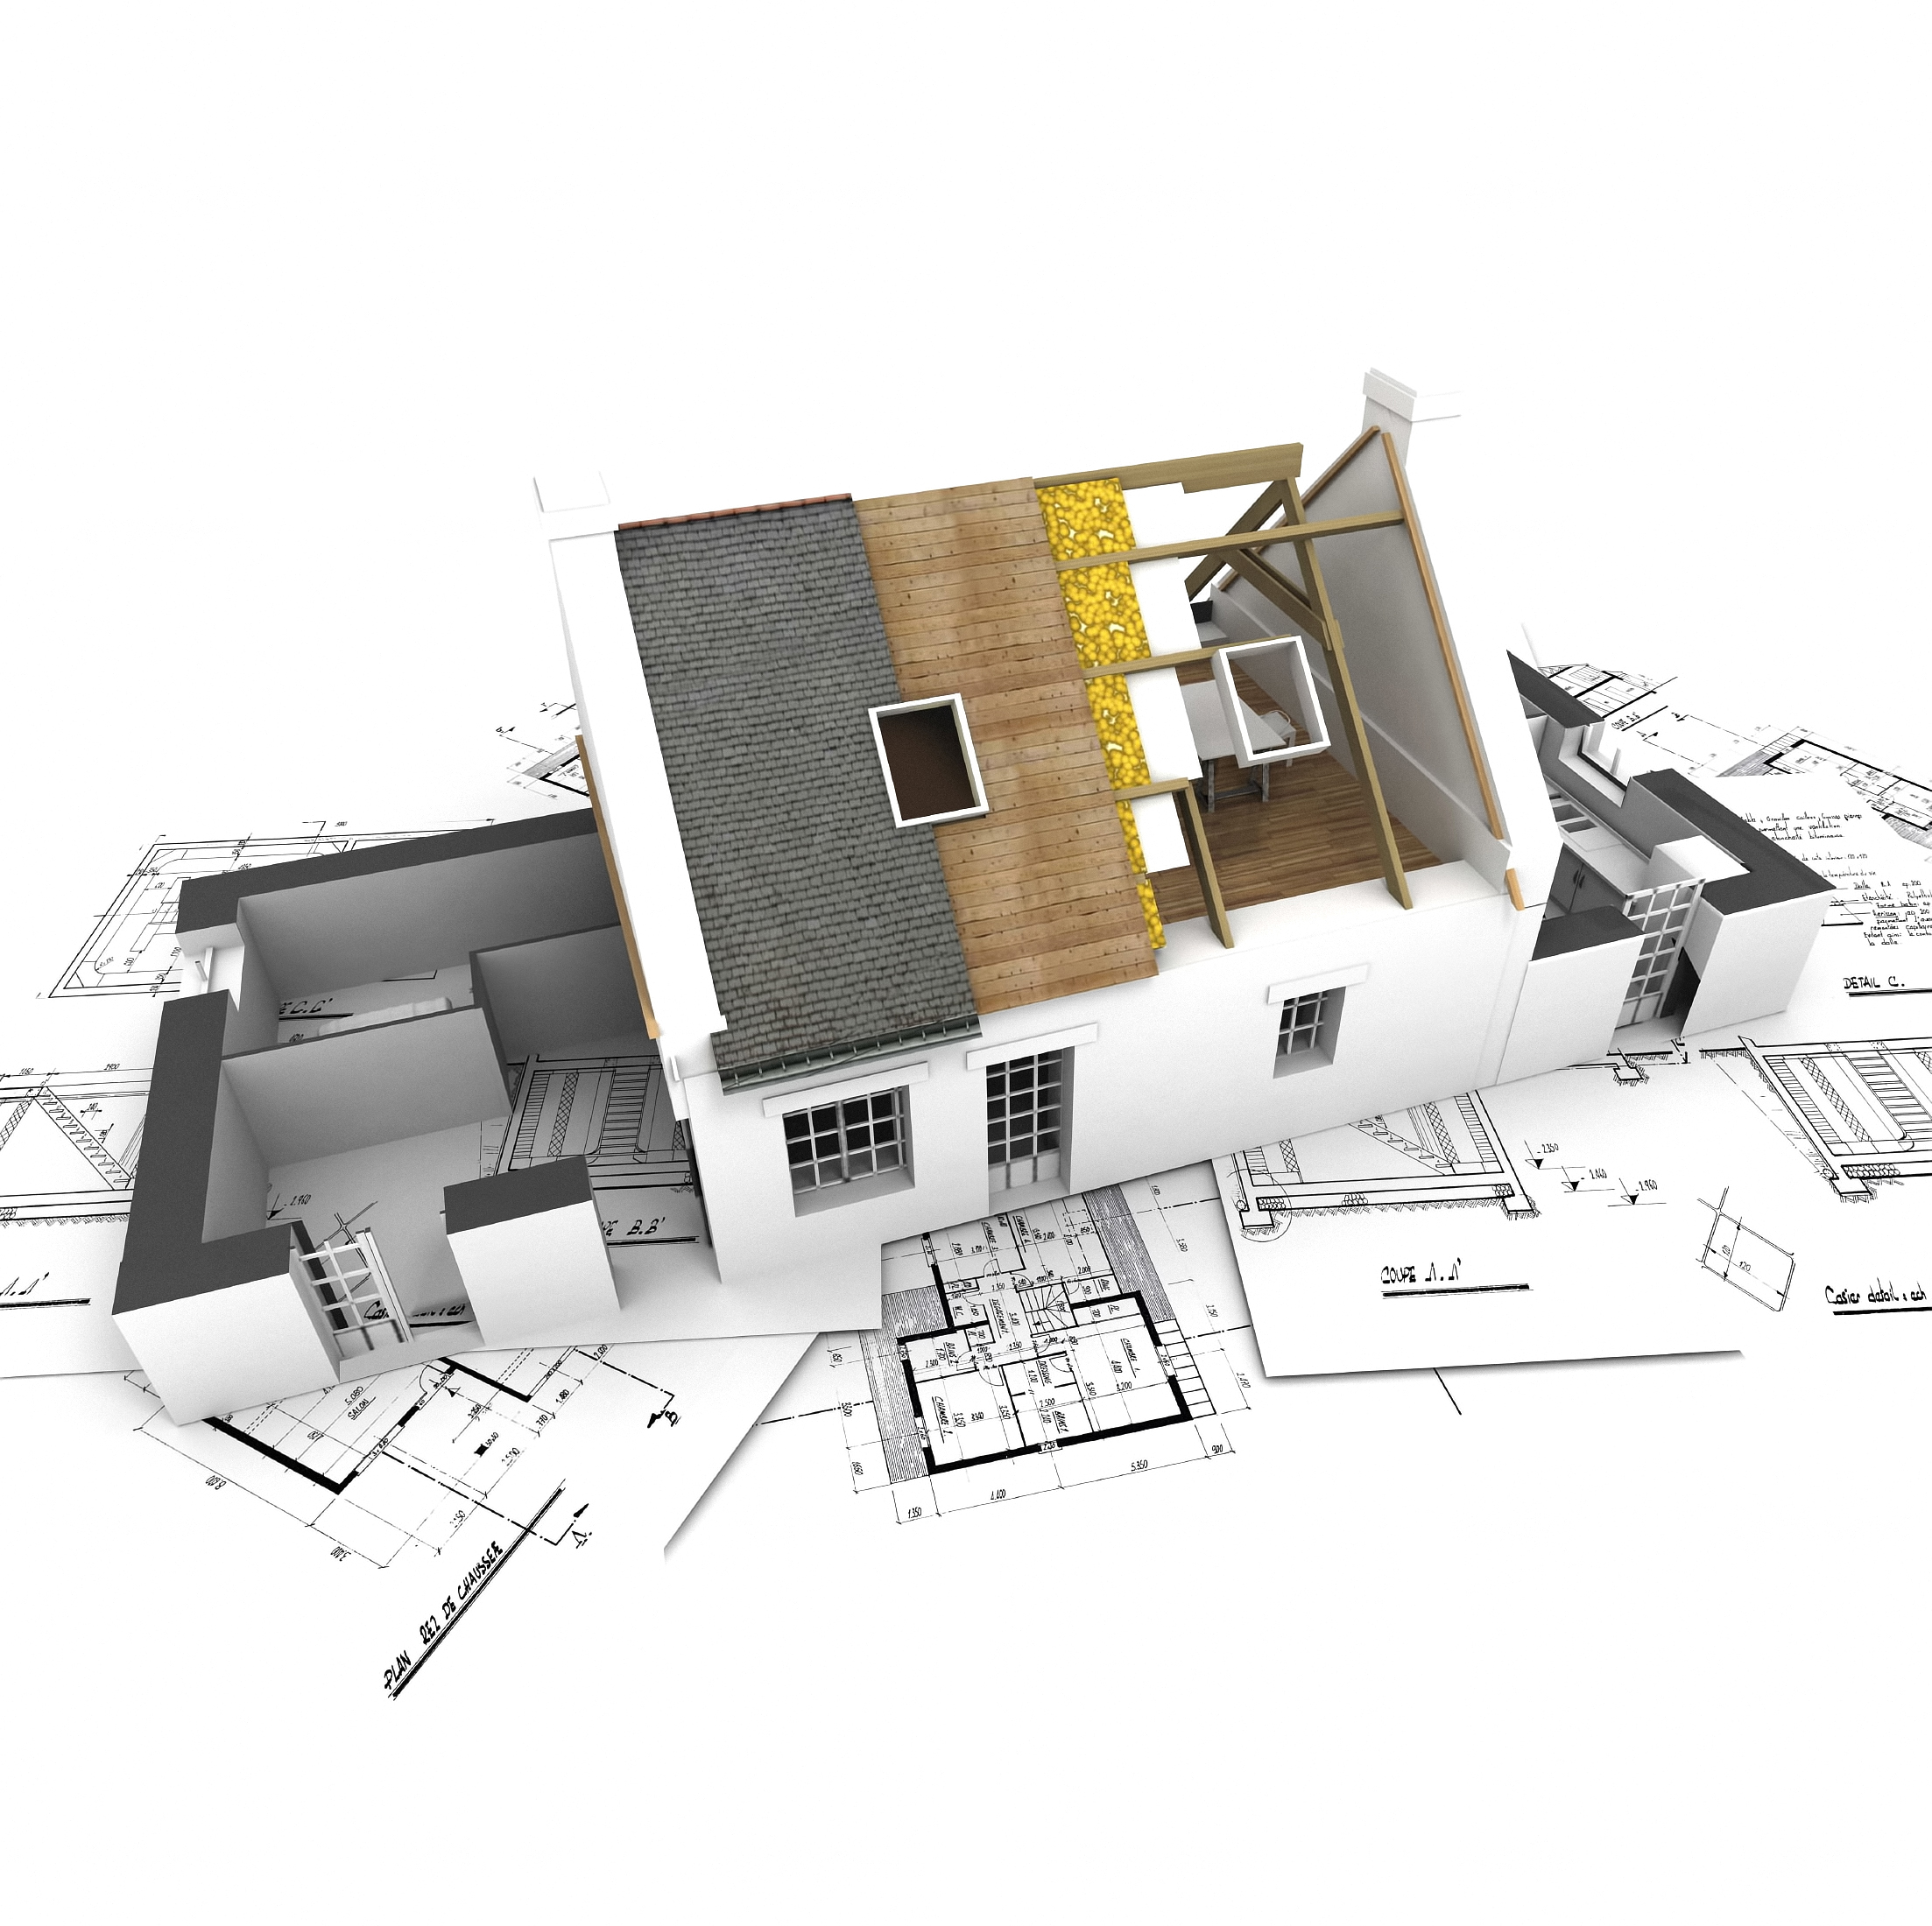
What is Architecture?
An Architecture of a system is
a model of that system
expressed in a language
describing system properties that should be understood and analyzed together
properties that are either explicitly stated by the model, or
properties that can be inferred via objective analysis of the model
A Viewpoint captures recurring properties, language definition, and analyses
Viewpoints are defined based on the kinds of questions they help answer
Services: what services are provided and required? interactions?
Security: what to secure? secure from whom or what? what are the security zones?
Deployment: where are deployable units run? what is the connectivity?
Consolidation: what applications are in use? where? for what? how do they overlap?
The language is associated with the viewpoint
So all systems’ deployment architectures are described in the same language
The language can take many concrete forms: tabular, textual, graphical, …
Viewpoint definitions should be standardized across systems
Architecture Styles take advantage of consistent separation of viewpoints
Architecture guides and captures key decisions to eliminate needless creativity in the further design, implementation, and evolution of a system

Slide 24
Architecture in Context
What architecture styles better meet goals?
Architecture Styles
Knowledge
Patterns
Principles
Refinements
Transformations
Goals
Objectives
Problems
Needs
Requirements
Constraints
the “real” problem
possible solution
solution approaches
lessons learned
Architecture
How best to make the changes?
implement, deploy, operate
conforms to, reverse engineer, adaptive feedback
Domain/System
Running
Operating
In the Real-World
Monitor : How well is the system meeting goals?
The architecture of a system is a key determinant of how well that system will meet business goals

Slide 25
A MAp Model of EA
The Company’s Financial Services Solutions always match Market and Customer Trends and Business Competition
1
Global Business Strategy keeps Financial Services Initiatives aligned with Enterprise Operating Model & Architecture via Enterprise Optimized Initiatives
Engineering and Market Delivery deliver Financial Services Solutions to market as planned in the Portfolio of Business Roadmaps
Market and customer trends
Financial Services Solutions
global
business
strategy
Portfolio of Business Roadmaps always reflects current, aligned, prioritized, committed and resourced Enterprise Optimized Initiatives
5
Business Competition
2
Portfolio of Business Roadmaps
Financial Services Initiatives
3
4
11
Business
Unit
Enterprise Optimized Initiatives
Each Business Unit keeps its Financial Services Initiatives responsive to Market, Customers, and Competition
Resources (1)
Enterprise Operating Model & Architecture is always current and effective
global
technology
strategy
Enterprise Operating Model
Enterprise Architecture
9
12
Technology and Technology Market Trends
Best Practices
Enterprise Strategy
7
IT Initiatives
8
Portfolio of IT Roadmaps
10
IT Solutions
Portfolio of IT Roadmaps also correspondingly planned, managed, and delivered into IT solutions in concert with Portfolio of Business Roadmaps.
Resources (2)

Slide 26
EA : Federated Goals and Alignment
goal
fact
domain
Goals align between parent and child initiative
Domains align between parent and child initiative
One initiative’s Assumption may be other initiative’s Goal

Slide 27
Goal Models precisely locate Risks
Risk 1: Parent goal wrong
What the goal formally states is not what is actually desired
Risk 2: Assumptions or analysis of Domain Properties wrong
The actual domain properties do not match the assumption
Risk 3: Logic wrong
The combination of domain properties and sub-goals does not meet parent
Risk 4: Sub-goals are not a good problem decomposition
Combining the solutions to sub-problems will make a tangled mess

Slide 28
Outline
What is MAp?
Formal Architecture Framework
Goal Modeling
Viewpoints and Concerns – Black Box, White Box, Technical
Architecture Style
Process Pragmatics
Iterative and Incremental
Multiple Project "Routes" through MAp
Flexible Models and Domains
Effective BPMN in MAp Business Architecture

Slide 29
What do Process Models enable?
Who does what?
Who uses what?
Who communicates with whom?
What information flows where?
Where are bottlenecks or pain points?

Slide 30
What do Goal Models enable?
Better communication of rationale for process and process change
Better process design to meet goals
More complete process management, including analysis and monitoring

Slide 31
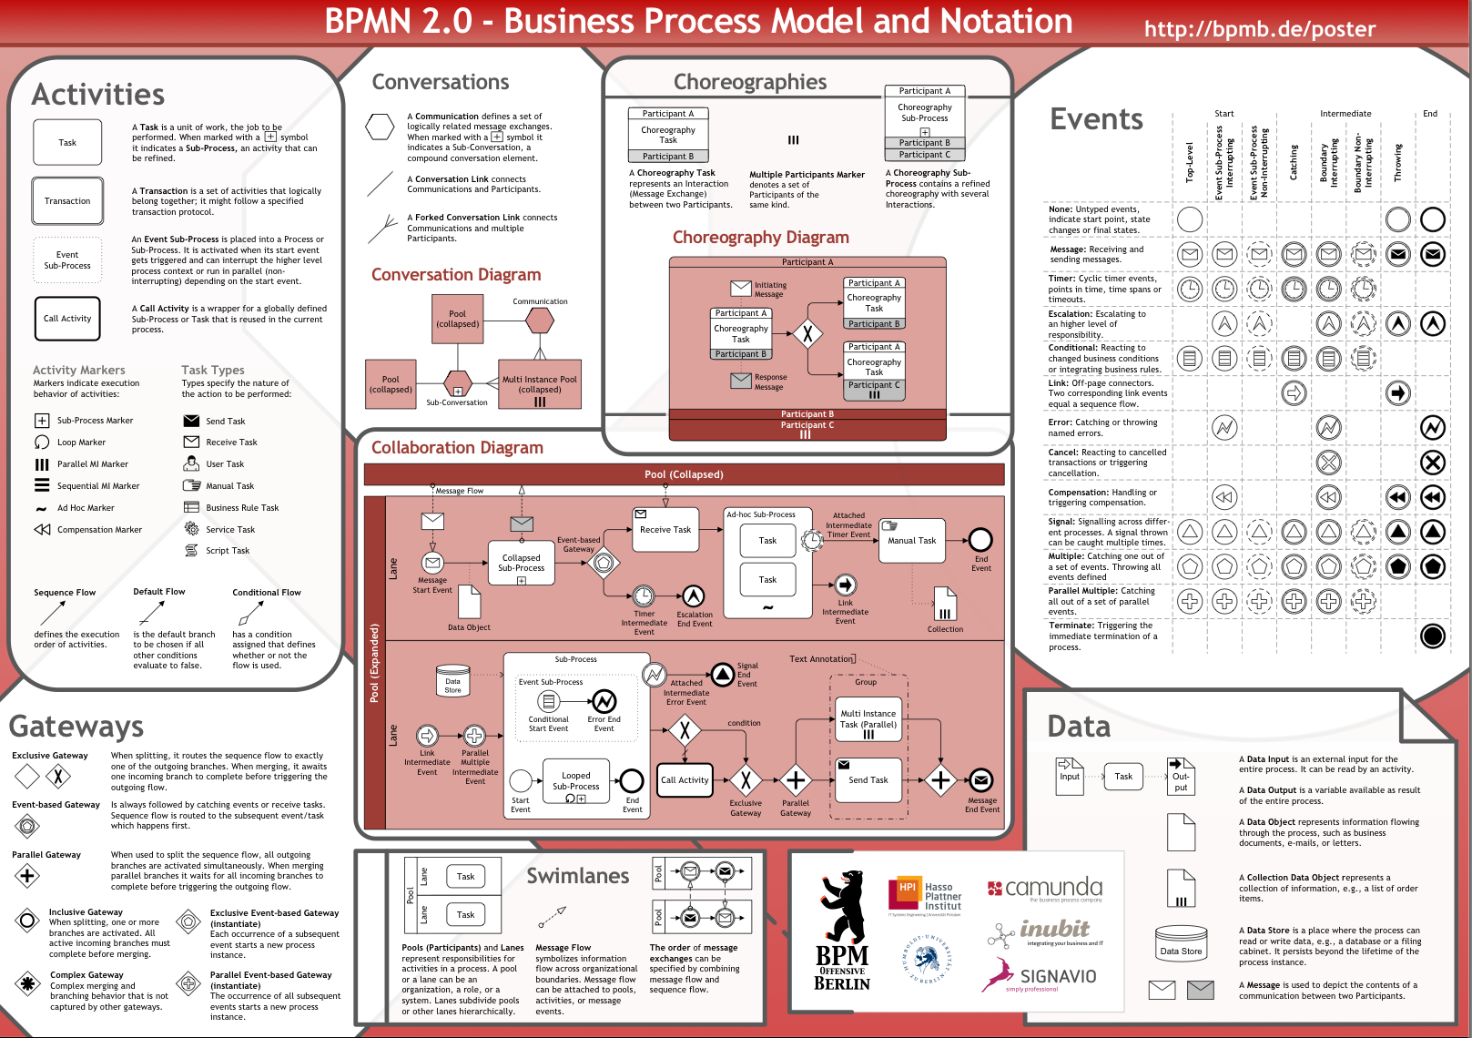

Slide 32
Using BPMN
Be clear about intent – execution quite different from communication
Use a subset of notation
Complement with goals and information
Include summary role / organization view with interfaces

Slide 33
Simple vs. Easy
Stages of use

